Slide 1
ChemCam PLS1 Sub-Model Calibration

Slide 2
Rationale for Sub-Models
We have had trouble coming up with single PLS1 models that can handle the full range of compositions
This should not be surprising: samples with high/low concentration of an element may have different spectral behavior (matrix effects) than samples with low/high concentration
Expanding the database helps with this somewhat, but a single model still isn’t enough
Instead, break the full composition range down into several sub-ranges, and develop a separate PLS model for each
Optimize # of components and normalization separately

Slide 3
Implementation
Use new Python code
Working with CCS files
Can restrict database by composition on the fly
Accepts input files to specify spectra to remove or keep, allowing outlier removal (if desired)
Automatically generates relevant plots, and lots of other useful output
Use the mlpy PLS algorithm, which gives identical results to our previous IDL PLS algorithm, given identical input
Use database with Sam’s ratio-based calibration transfer to partially correct Earth-Mars differences

Slide 4
Optimization
Use plots of:
RMSECV (cross validation RMSE)
RMSEC (RMSE of full model predicting the training set)
RMSEP (RMSE of full model predicting the test set)
RMSEP for cal targets (RMSE of full model predicting the 95A Mars cal targets)
Compare norm1 and norm3, up to 20 components
Try to choose # of components corresponding to “elbow” in curves where possible
Adjust for minima in cal target RMSEP, where relevant/possible

Slide 6
Predictions
Calculate a “full” prediction using a composition range of 0 to 100 wt.%
Calculate sub-model predictions (usually two or three sub-models)
Combine the predictions using simple logic:
For example: If full model predicts <5 wt.%, use “low” submodel. If Full model predicts >15 wt.% use “high” submodel. Else use “mid” sub-model.
We will probably want to do something to smoothly transition between sub-models
Lots of “knobs” we can adjust to tune the results:
Change logic used
Change norm, NC
Change submodels

Slide 7
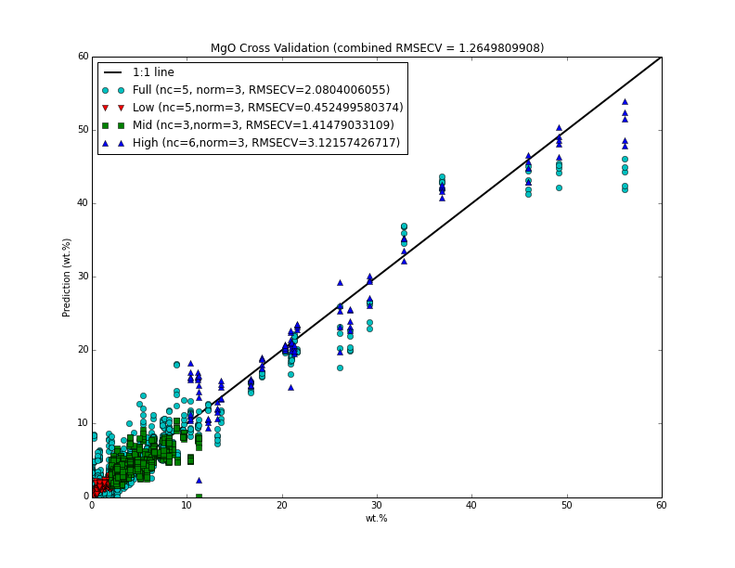
Note: These RMSE #s obviously need to be rounded…

Slide 8
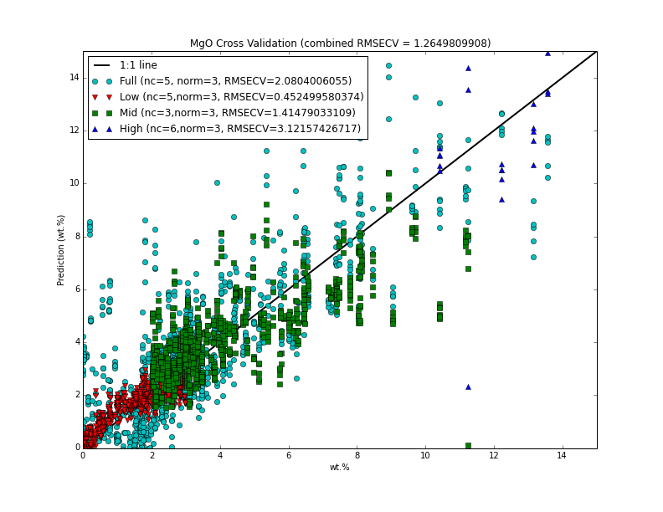
Note: These RMSE #s obviously need to be rounded…
Note: MgO low model
much better than full model for low compositions

Slide 9
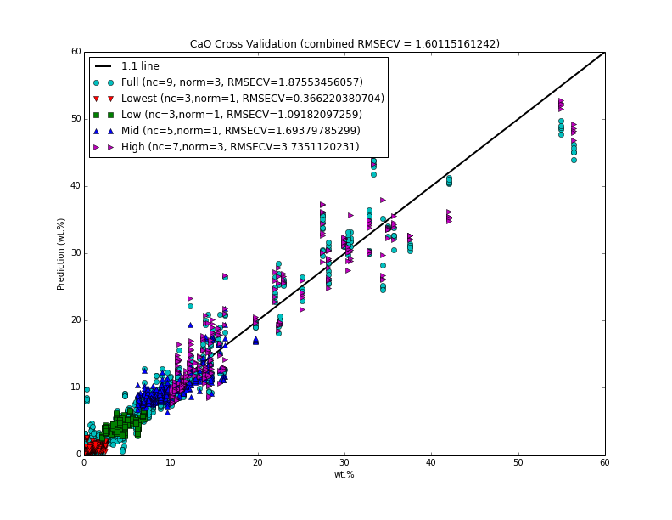
Note: These RMSE #s obviously need to be rounded…

Slide 10
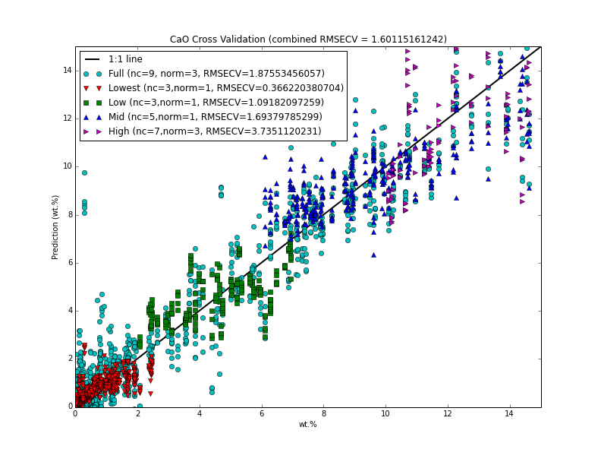
Note: These RMSE #s obviously need to be rounded…

